Slide 1
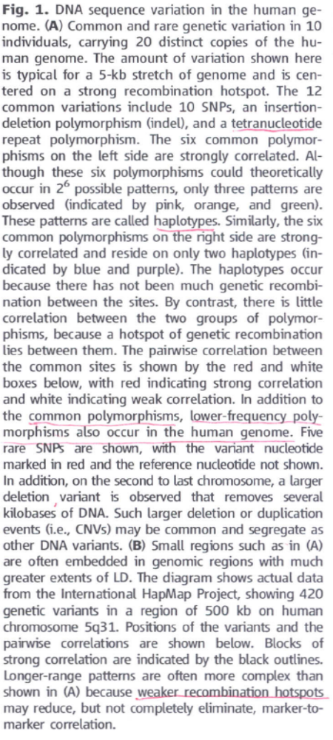
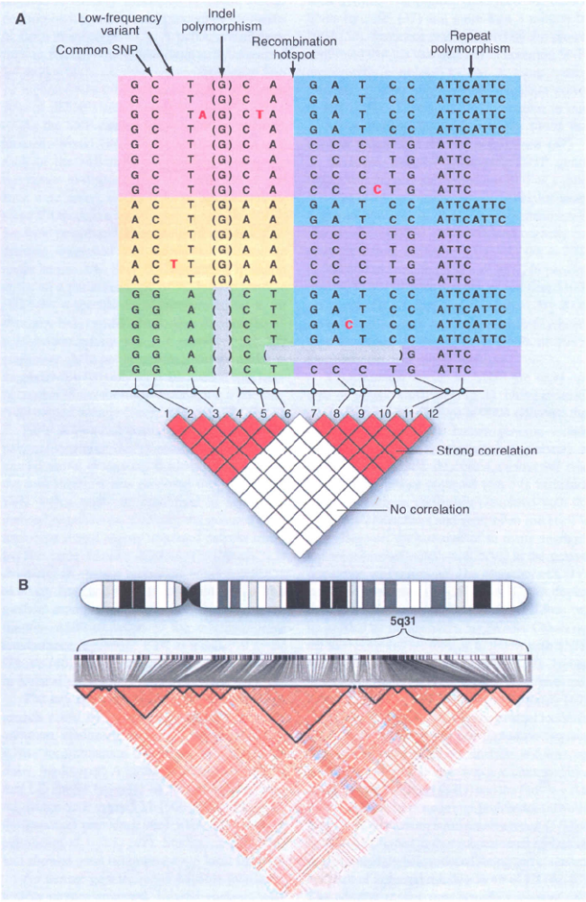
From of “Genetic Mapping in Human Disease”
David Altshuler et al., Science vol 322 November 7, 2008

